Slide 1
An augmented reality(ar) app
TEAM MEMBERS:
KUNDETI PAVAN KUMAR 19BCE1821
GAUTAM SRINIVASAN 19BCE1643
D.N.S.KOWSHIK 19BCE1363

Slide 2
Cse3016
COMPUTER GRAPHICS and MULTIMEDIA
Faculty:
DR.PAVITHRA L K ma’am

Slide 3
Introduction
Augmented Reality is a technology that has changed the face of smartphone apps and gaming. ... AR apps act as a magic window for the viewers that lets them see the holograms and manipulate 3D models.
We will be using an updated version of UNITY for developing and making the scene and an updated version of VUFORIA for the database and that makes the user experience more interactive and refining.

Slide 4
Introduction (CONTD..)
A simple augmented reality use case is: a user captures the image of a real-world object, and the underlying platform detects a marker, which triggers it to add a virtual object on top of the real-world image and displays on your camera screen. AR applications can become the backbone of the education industry.

Slide 5
Motivation
The purpose of this was to measure and understand the impact of an augmented reality mobile application
The results showed that using an augmented reality mobile application increased the learning motivation of students. The attention, satisfaction, and confidence factors of motivation were increased, and these results were found to be significant. Although the relevance factor showed a decrease it proved to be insignificant.

Slide 6
Objective
To create an Augmented reality app for education/knowledge purpose and to increase the reach of knowledge to every person using the graphics in the database of VUFORIA.
To explain the concepts/theories and various interesting topics around the world by taking the person to a hybrid environment and showing them the 3D-virtual reality experience with the help of audio/video.

Slide 7
Existing Work Discussion
AR combines real and virtual worlds, supplementing the real world with computer-generated virtual objects in real-time. According to one of the most commonly accepted defnitions, AR is said to be a technology that has three key requirements: combining of real and virtual objects in a real environment, aligning of real and virtual objects with each other, and real-time interaction.
But the idea of using AR app in the education field or online surfing was not developed till date, where this app developed by UNITY and VUFORIA helps students or people around the world to gain knowledge with the help of already existing pictures explained in a graphical/virtual reality way.

Slide 8
ARCHITECTURE
Here we will be using UNITY and VUFORIA for developing the AR app.
Unity is a cross-platform game engine developed by Unity Technologies, As of 2018, the engine had been extended to support more than 25 platforms. The engine can be used to create three-dimensional, two-dimensional, virtual reality, and augmented reality games, as well as simulations and other experiences.^{[4][5]} The engine has been adopted by industries outside video gaming, such as film, automotive, architecture, engineering and construction.

Slide 9
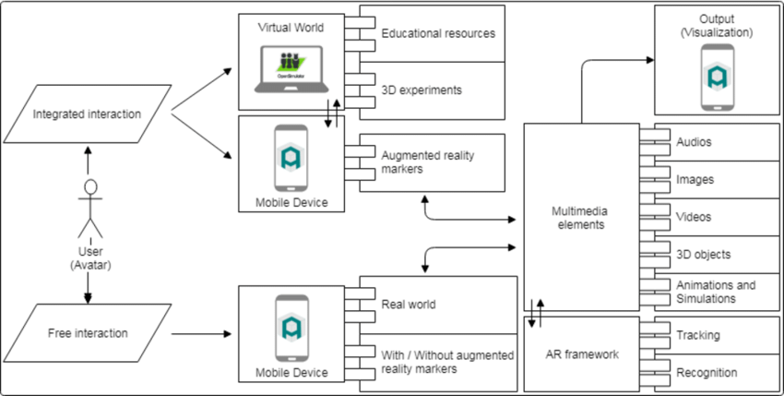
ARCHITECTURE OF ar app

Slide 10
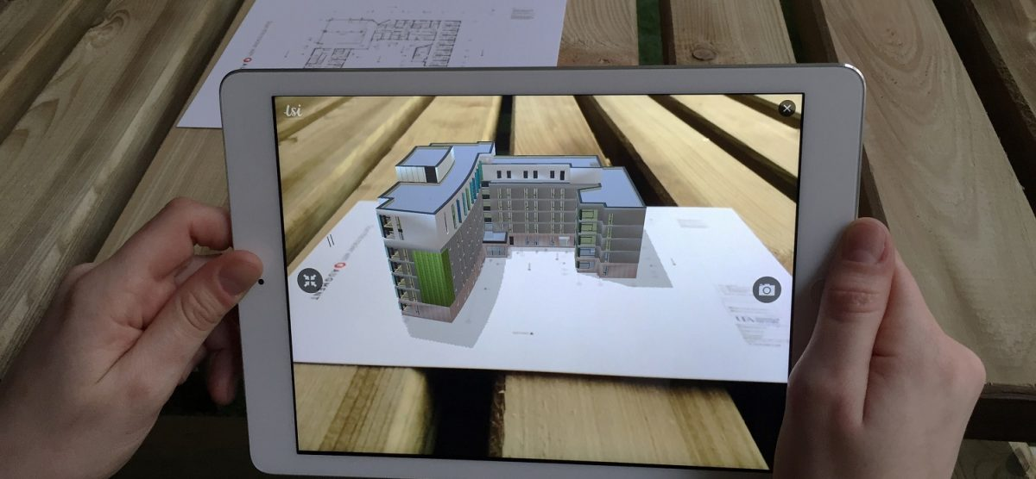


Slide 11

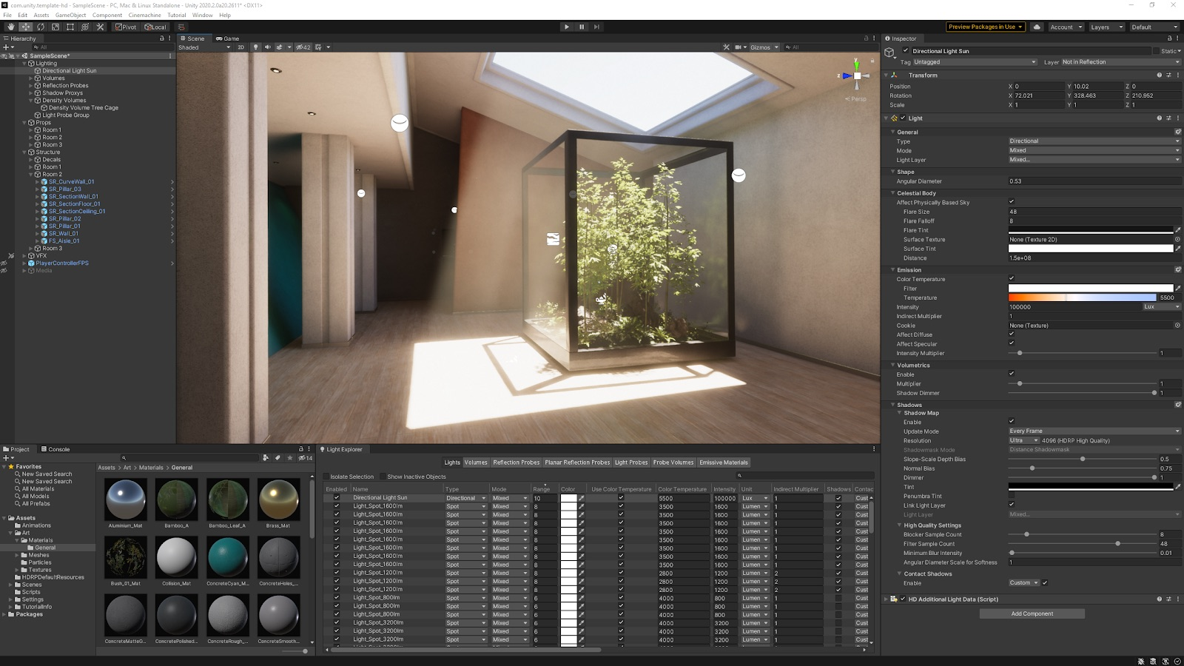
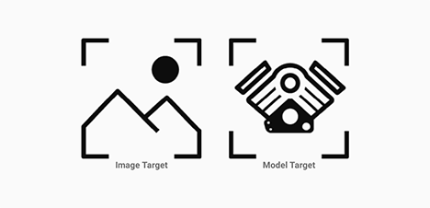

Slide 12
Requirement analysis
Software Requirements-
UNITY 3D and VUFORIA progams.
Operating system like Windows 8 and Windows 10 is the platform required
A Visual C++ compiler is required for compiling the source code to make the executable file which can then be directly executed.

Slide 13
Hardware Requirements-
The hardware requirements are very minimal and the software can be made to run on most of the machines. Processor: Above x86 Processor speed: 500 MHz and above
RAM: 64 MB or above storage space 4GB and more
Monitor Resolution: A color monitor with a minimum resolution of 640*480

Slide 14
MODULES
MODULE-1
VUFORIA
We will be deploying and installing the Vuforia in UNITY 3D application and setting up the scenes and required assets for the AR app and also deploying a camera in the scene environment under the UNITY GAME COMPONENT section.
Finally Making a 3D view environment in the UNITY application.
Here we will implement a user controlled camera to navigate 3D worlds using keyboard and mouse input

Slide 15
MODULE-2
DATABASE
Here we will be creating a database in Vuforia Application and setting up the requires constraints and linking it to the UNIITY 3D app and adjusting the sample images/graphics with a precised coordinates and linking those pictures with audio/video clips for the understanding which makes the user experience more interactive and refining.

Slide 16
Module-3
Here in module-3 we will be making an android app and other requirements in a smartphone using Android studio by connecting the smartphone to the AR app developing pc/laptop and then we link our database(VUFORIA) to UNITY and deploying to the smartphone(!! The smartphone must run on an any Android operating system).
Finally the Augmented reality App can be used on the smartphone after completing the above phases and the main highilight thing is the AUGMENTED REALITY App works without network connection too.

Slide 17
REFERENCES
https://www.google.com/search?q=UNITY3d&rlz=1C1CHBF_enIN881IN882&oq=UNITY3d+&aqs=chrome..69i57j69i60l4.7572j0j9&sourceid=chrome&ie=UTF-8#
https://www.youtube.com/watch?v=1ZTSF93PXQc
https://www.youtube.com/watch?v=Ml2UakwRxjk&t=179s
https://en.wikipedia.org/wiki/Augment_(app)
https://www.viewar.com/blog/
https://mobidev.biz/blog/augmented-reality-future-trends-2018-2020
https://www.coursera.org/learn/ar
https://www.youtube.com/watch?v=CW2xBwYgRRc

Slide 18
THANK YOU!!!

